Slide 1
Acknowledgements
I, Sandip Gujar - a student at Simplilearn, thank all the staff of Simplilearn for extending full support and co-ordination in my endeavor of following the “Data Scientist Course” through the Simplilearn LMS.
In this strive, while learning “Tableau Desktop 10 qualified Associate”, the trainer Mr. Ramanathan Somasundaram taught us, guided us and mentored us wonderfully. He has been kind to cooperate and help. This project has come through, because of his excellent teaching and concept clearing skills.
Mr. Ramanathan’s knowledge on Tableau is excellent and simply superb. I wish him the best for his future goals and achievements.
I convey my gratitude to Simplilearn, Mr. Ramanathan and all staff members of Simplilearn.

Slide 2
Project 1 -Comparative Study of Countries
DESCRIPTION
Problem Statement:
Create a dashboard to do a comparative study on various parameters of different countries using the sample insurance dataset and world development indicators dataset.
Datasets
Primary Dataset – Insurance Sample Dataset
Secondary Dataset – Global Financial Development Database
Hint: (Use Data Blending with Relationships between Country Code, Country, and Year)
Dashboard Description
A geographic map showing countries field. Color the map based on Income column from the secondary dataset.
Include a filter of income group to the dashboard
Include a webpage to show data from world bank webpage driven by an URL action from geography graph.
The country names in the map will act as the trigger https://data.worldbank.org/country/<country>?view=chart

Slide 3
Project 1 -Comparative Study of Countries (contd…)
Dashboard Description (continued)
Create a KPI Table to show the comparison between the selected period and the prior period to the selected one.
Create two parameters for Year Selection and Category Selection.
Category Parameter to have Life Insurance Share, Market Share, Penetration, Ratio of Reinsurance Accepted & Retention Ratio
Create a calculated field to calculate the Growth %.
Create a table to show these values as shown.
Title to be updated based on the category selection Create Growth Indicator Shapes based on the Growth %.
Growth indicator to display Negative, No Change and Positive as values and corresponding shapes against it.
Create a trend line to show the selected category values.
The line to show with a arrow/triangle at the last mark
Dashboard filter for income group to be applied for all charts with the filter action enabled in the map as well
Formatting to be done appropriately

Slide 4
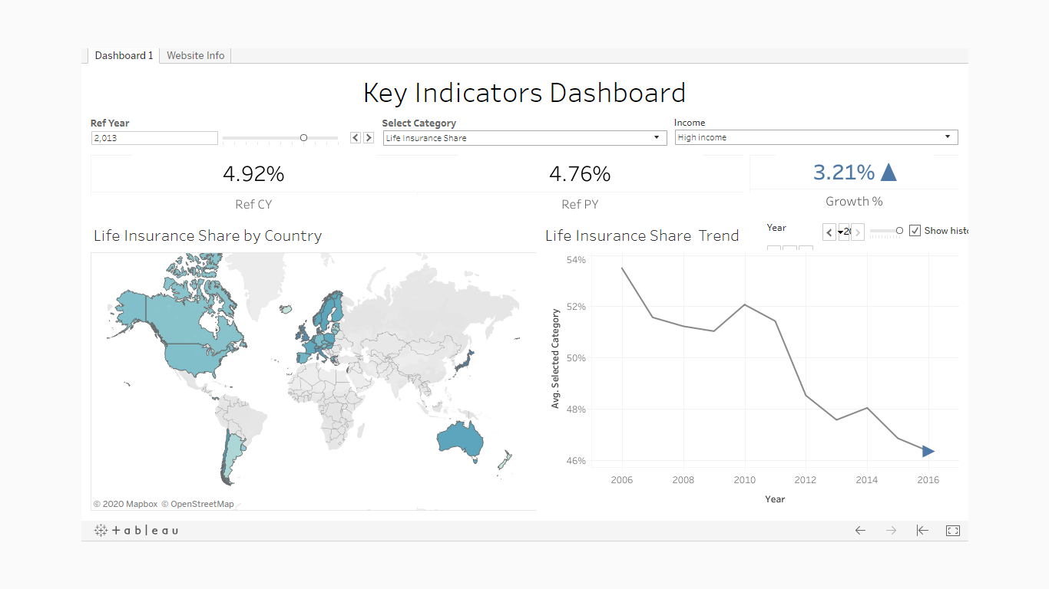
Analysis 1. 1 .A geographic map showing countries field. Color the map based on Income column from the secondary dataset. 1a.Include a filter of income group to the dashboard

Slide 5
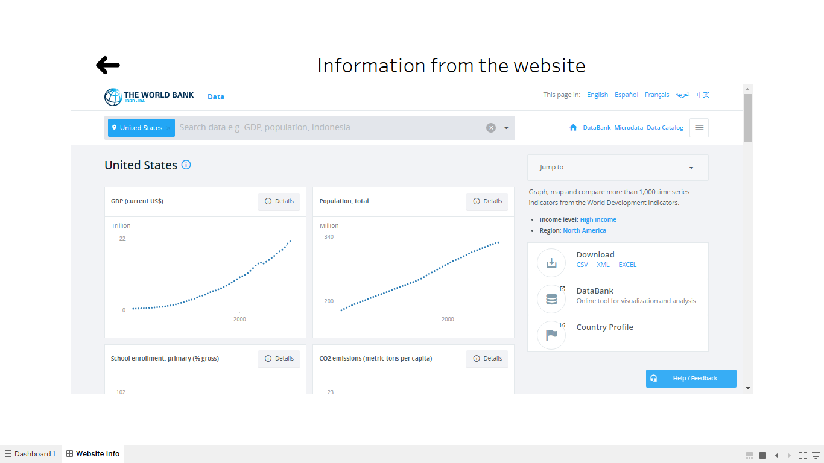
Analysis 2. 2.1 Include a webpage to show data from world bank webpage driven by an URL action from geography graph. 2.2 The country names in the map will act as the trigger https://data.worldbank.org/country/<country>?view=chart

Slide 6
Analysis 3. 3.1 Create a KPI Table to show the comparison between the selected period and the prior period to the selected one. 3.2 Create two parameters for Year Selection and Category Selection. Category Parameter to have Life Insurance Share, Market Share, Penetration, Ratio of Reinsurance Accepted & Retention Ratio

Slide 7
Analysis 3 (contd..1) 3.3 Create a calculated field to calculate the Growth %. Create a table to show these values as shown. 3.4Title to be updated based on the category selection Create Growth Indicator Shapes based on the Growth %.

Slide 8
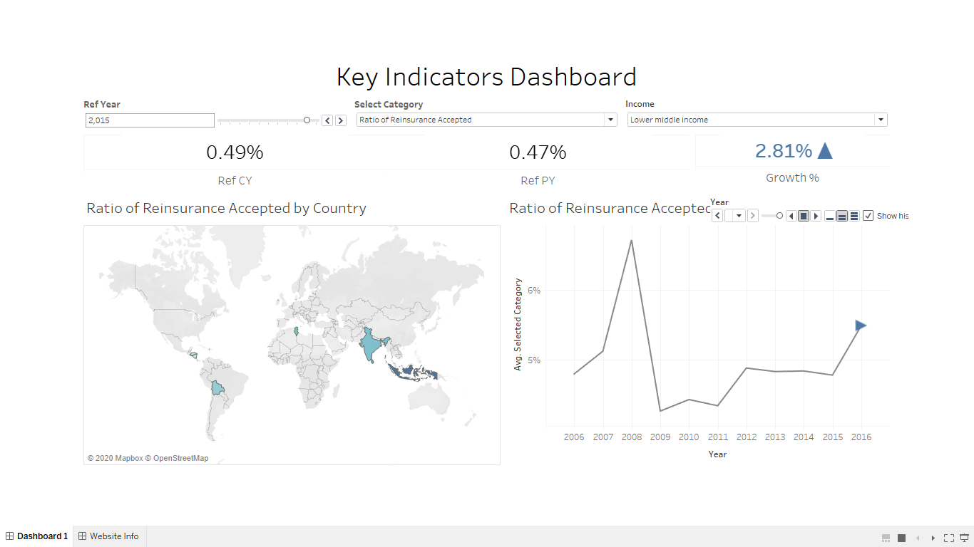
Analysis 3 (contd..2) 3.5 Growth indicator to display Negative, No Change and Positive as values and corresponding shapes against it.

Slide 9
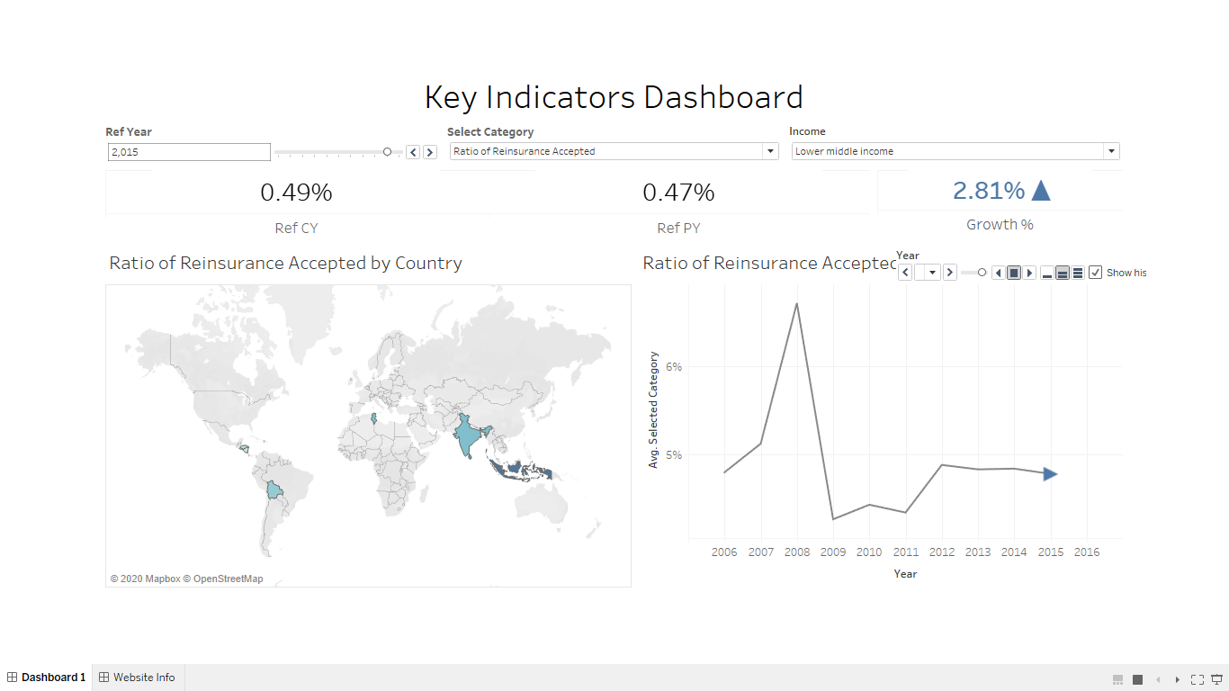
Analysis 4 4.1 Create a trend line to show the selected category values. 4.2 The line to show with a arrow/triangle at the last mark

Slide 10
Analysis 5 5 Dashboard filter for income group to be applied for all charts with the filter action enabled in the map as well

Slide 11
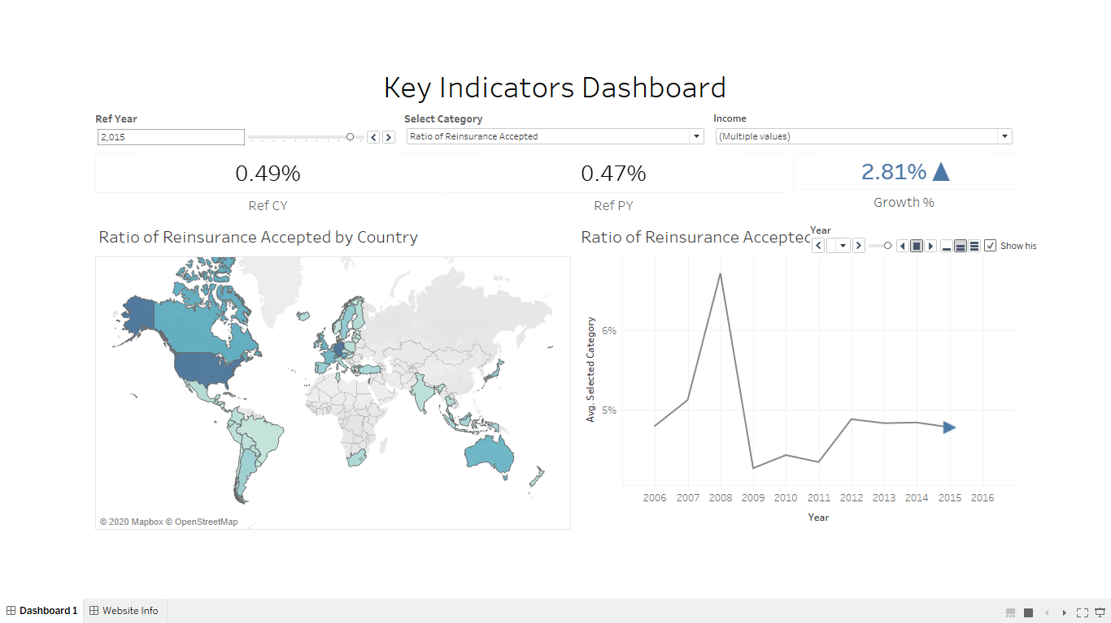
Analysis 6 6 Formatting to be done appropriately

Slide 12
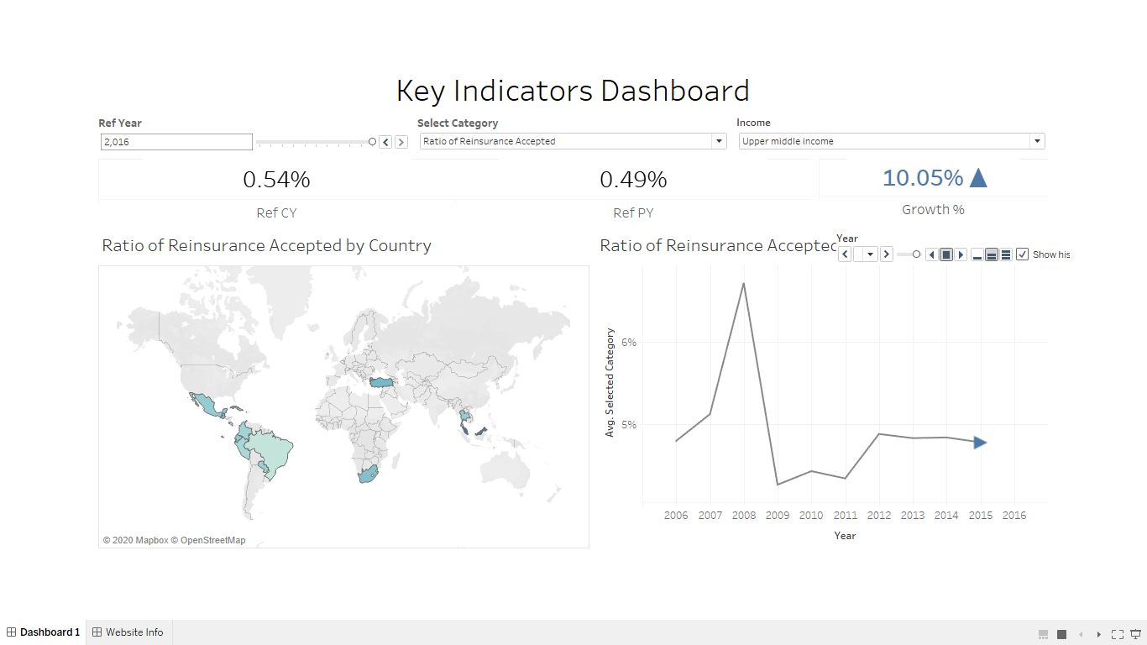
Final Output
End Of Project

